Slide 1


10 January 2018
APEX v1.1.1
User guide
Karsten de Braaf

Slide 2
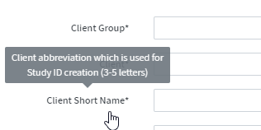



User support
Intro | Study Management | Data Input | Data controls | Run Management | Study validation | Table Library
Where can I find support?
This document
Overview on most important features and common questions
Data dictionary
Data formats for all upload files, including samples
Platform hover-over
Context information provided to many platform fields
Manual - WIP
Technical documentation on platform functionalities and calculation engine
Yammer community
Share your ideas and questions on https://www.yammer.com/scor.com/#/threads/inGroup?type=in_group&feedId=12694553
Support team
Florian Piolain Rachid Belhassaini Karsten de Braaf
EA platform Calculation engines / SAS General support

Slide 3
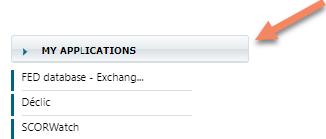
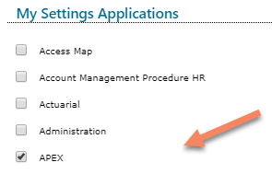

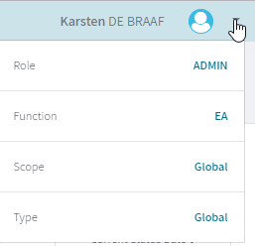
APEX access and user login
Intro | Study Management | Data Input | Data controls | Run Management | Study validation | Table Library
http://dcvprdexpan:8080/expan/study
Or via intranet “My Applications”
Use
Automatic log-in via your Windows ID
You can check your user attributes in the top-right corner
If you want to test the platform you can use the test environment: http://dcvuatexpan:8080/expan/study

Slide 4
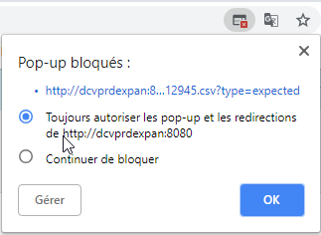

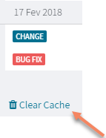
APEX technical details
Intro | Study Management | Data Input | Data controls | Run Management | Study validation | Table Library
The first time you want to download or visualize a document from APEX you might need to manually allow pop-ups within your browser. For Chrome the option is presented in the top-right corner:
If you encounter an unexpected behavior within APEX, try to clear the cache of your browser:

Slide 5
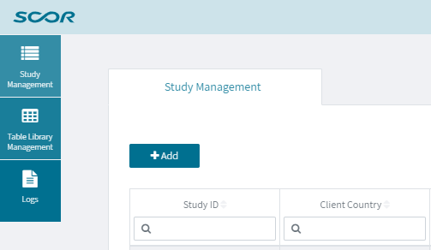
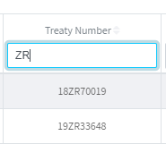
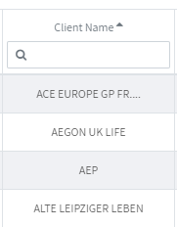
Study Management
Intro | Study Management | Data Input | Data controls | Run Management | Study validation | Table Library
Main screen of APEX, listing all studies created
All studies are displayed, but access is subject to user access rights
List can be filtered and sorted by various characteristics (metadata)
Most filters defined as “partial search”
Fields can be sorted ascending or descending

Slide 6
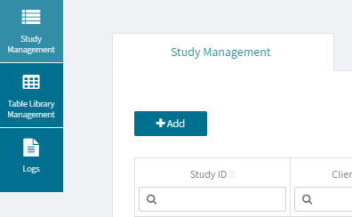


Study Creation
Intro | Study Management | Data Input | Data controls | Run Management | Study validation | Table Library
Create new study
Study Documentation: only one file accepted. Use winzip in case of multiple documents
Start / End of Observation Period: Enter maximum period provided in data. Observation period can be restrained later as part of the run setting
Client: List of clients based on Omega Client Name, updated weekly including new clients entered in Salesforce
Client Short Name: Client name used as part of the unique study ID, therefore requiring a manual abbreviation
Line of Business: Following EA main risk type for now, awaiting SGL standardisation
Study ID: Defined as combination of key metadata: CountryCode_ClientShortName_StudyClient_CreationYear_Index
APEX field
Data variable

Slide 7
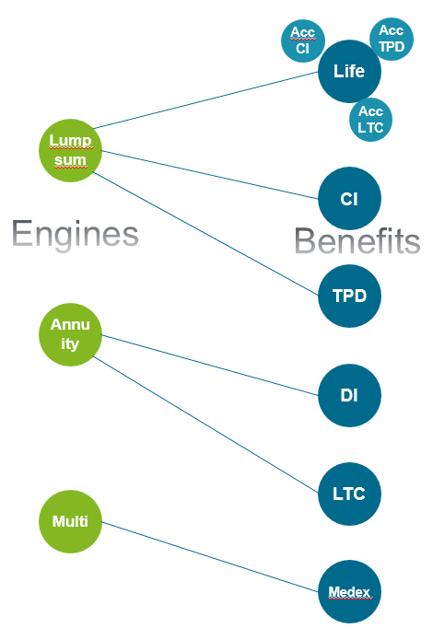
Calculation engine and benefit structure
Intro | Study Management | Data Input | Data controls | Run Management | Study validation | Table Library
During the planning phase an inventory of all current EA activity was performed and the project team assessed all existing calculation methods to define the diversity of calculation engines needed. In conclusion it was decided that at most three engines would be required:
Lump-sum engine for all products with a single terminating event: Life (mortality + longevity) including acceleration benefits, CI and TPD
Annuity benefit engine for all products with multiple status, typically including a healthy and a claimant status: DI and LTC
Multi benefit engine for all products with multiple single payments, with potentially varying claim amounts: Medex
The structuring of Annuity and Multi engine will be re-assessed in advance of the next development phase (2019)

Slide 8
Input Data – data structure
Intro | Study Management | Data Input | Data controls | Run Management | Study validation | Table Library
A standard data structure has been defined as basis for the calculation engines: “One line per exposure condition”
For a standard portfolio with lump-sum risk it corresponds to one line per policy
In case of changing sum insureds, one line per sum insured is entered
For later engines (e.g. DI) one line per policy status (incidence / reactivation / …)
Additional data structure(s) will be integrated for next phase. In particular data in “snapshot format”
Key variables defining the exposure period:
Date_of_Begin_Current_Condition: For first status typically corresponds to Date of Commencement. Might be later in specific situation, like missing information due to client mergers
Date_of_End_Current_Condition: Date of known change in exposure condition. Leave empty in case of unchanged condition. Do not enter future dates, like policy maturity date
Status_Begin_Current_Condition: Active / Claimant (for later engines)
Status_End_Current_Condition: Status at end of period in case of a change in condition. Otherwise leave empty
Active: No event. Change in exposure condition due to other reasons (change in sum insured)
Dead
Claimant: Incidence of claim related to given product coverage (CI / TPD / DI/ LTC)
Withdrawn: Policy withdrawal/ lapse
Expired: Expiry / Maturity of policy.
Censored: Censored exposure information with unknown reason
Claimant_Dead: In case the reason of claim is unknown, e.g. for some Accelerated CI portfolios
APEX field
Data variable

Slide 9
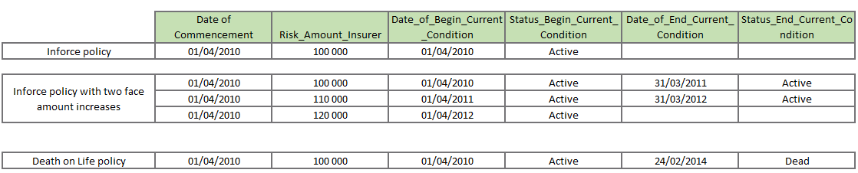

Input Data – data structure
Intro | Study Management | Data Input | Data controls | Run Management | Study validation | Table Library
Examples
All dates are inclusive of the day!
Observation period = 01/01/xx to 31/12/yy

Slide 10
Input Data – events
Intro | Study Management | Data Input | Data controls | Run Management | Study validation | Table Library
Events
Dedicated variables describe the cause and timing of events. This allows to retain more flexibility, in particular covering portfolios where no link between exposure and claim information is possible
Date_of_Event: Events are assumed end of the day. For lump-sum engine the date therefore needs to match Date_of_End_Current_Condition Pay attention to the date conventions of the cedent. For example, some cedents may assign lapses to the first day of the following policy year. In such case you would need to adjust dates to match the correct policy year. Type_of_Event: Types are consistent with Status_End_Current_Condition
Type_of_Event | Status_End_Current_Condition
Incidence | Claimant
Death | Dead
Withdrawal | Withdrawn
Incidence_Death | Claimant_Dead
 | Expired / Censored

Slide 11
Decrement structure
Intro | Study Management | Data Input | Data controls | Run Management | Study validation | Table Library
Decrements represent the types of risks analysed in a study, corresponding each to a type of change in policy status:
Claimant
Lump-sum
Annuity
ix
Active
qx
Dead
wx
Withdrawn

Slide 12
Decrement structure
Intro | Study Management | Data Input | Data controls | Run Management | Study validation | Table Library
An additional decrement type ix+qx has been created to cover portfolios where no distinction between incidences and deaths is possible, for example in case of Accelerated CI products with no information on the cause of claim.
The link between decrements and Exposure status is as follows:
Whenever possible all types of policy status should be captured in the same Input file, allowing the calculation of all decrements within the same study
The only exception is with respect to ix+qx, which cannot be mixed with neither ix nor qx, as otherwise there is no clear allocation of exposures to

Slide 13
Exposure selection
Intro | Study Management | Data Input | Data controls | Run Management | Study validation | Table Library
The input data can contain a mix of different types of products and risks (e.g. Life, Standalone CI and Accelerated CI)
Depending on the chosen decrement, the calculation engine will define the exposure by filtering policies based on the following rules:
Decrement | Exposure selection
qx | Main_Risk_Type = “Life”
ix | Main_Risk_Type in {“CI”, “TPD”, “LTC”, “DI”, “Health”} or Acceleration_Risk_Type in {“CI”, “TPD”, “LTC”}
wx | all
ix+qx | all

Slide 14
Amounts
Intro | Study Management | Data Input | Data controls | Run Management | Study validation | Table Library
Exposure Amount
Exposure amount relevant for the given study should be provided, typically Sum Insured or Sum at Risk
Both original (insured) and reinsured amounts can be uploaded, providing flexibility in the run setting to test both basis: Risk_Amount_Insurer and Risk_Amount_Reinsurer
For acceleration products, the exposure amount of the accelerated benefit needs to be provided separately. This allows flexibility for products with partial acceleration benefits: Acceleration_Risk_Amount_Insurer and Acceleration_Risk_Amount_Reinsur⁽¹⁾
Event Amount
Exposure for claims/events needs to be provided separately: Event_Amount_Insurer and Event_Amount_Reinsurer
abbreviated as SAS only supports 32 character length

Slide 15
Input Data – other key variables (1/2)
Intro | Study Management | Data Input | Data controls | Run Management | Study validation | Table Library
Policy Duration
Date_of_Commencement: Start of benefit coverage.
Date_of_commencement is optional. If it is not provided, then no slicing by policy duration will be possible
Date_of_last_medical_selection: Last medical underwriting of policy (for example in case of re-underwriting to support coverage increase or in case the policy results from a conversion without new underwriting)
By default Date_of_commencement is used to calculate the duration of the policy. If Date_of_last_medical_selection is entered, then it is used instead
Attained Age
Date_of_Birth
Is optional. If it is not provided, then no slicing by attained age will be possible
In case only Age_at_commencement is available, then Date_of_Birth needs to be estimated by the user
Age_at_commencement
Is only used as result dimension. Not used for attained age slicing
Exposure end
Benefit_End_Date
Used to limit exposure, in case Date_of_End_Current_Condition is absent
Benefit_Term_Years
In absence of Date_of_End_Current_Condition and Benefit_End_Date then exposure is limited to Date_of_commencement + Benefit_Term_Years

Slide 16
Input Data – other key variables (2/2)
Intro | Study Management | Data Input | Data controls | Run Management | Study validation | Table Library
Exposure identification
Different ID variables are available to allow the distinction of different exposures and the identification of data lines belonging to the same exposure
IDs only have the purpose of matching data within the bounds of EA and should never be filled with official ID’s or original policy numbers!
Life_ID: technical ID to identify data lines belonging to the same person
Policy_ID: technical ID to identify data lines belonging to the same policy
Benefit_ID: benefit name to distinguish different benefits within the same policy, e.g. Life and CI
Retro_Legal_entity: In case amount experience is analyzed by retrocession share, this variable is used as additional component in the unique ID definition
In summary the unique ID of an exposure is defined as Life_ID + Policy_ID (+ Benefit_ID) (+ Retro_legal_entity)
Life_ID and Policy_ID are required for the definition of the unique ID, whereas Benefit_ID and Retro_legal_entity are optional and added to the unique ID only if provided

Slide 17
Calculated fields (1/2)
Intro | Study Management | Data Input | Data controls | Run Management | Study validation | Table Library
In addition to the slicing dimensions, the following dimensions are calculated or modified by the engine:
Year_of_commencement = Year of Date_of_commencement
Date_of_end_current_condition: If empty then exposure is minimized with
Benefit_end_date if provided, otherwise with
date_of_commencement + benefit_term_years, if provided
Partial_duration:
Indicator for exposures based on incomplete policy year
Provided for wx decrement. Allowing to avoid seasonality effects for lapse analysis
Expected_1_boundary:
Indicator if expected value is based on exposure outside of expected table scope
For slicing dimensions (Age_attained, duration_year and calendar_year) a value outside of the table scope is set equal to the corresponding min or max
Added only for first expected basis

Slide 18
Calculated fields (2/2)
Intro | Study Management | Data Input | Data controls | Run Management | Study validation | Table Library
In addition to the slicing dimensions, the following dimensions are calculated or modified by the engine:
Insurance_age_attained: Calculated if:
no Attained Age slicing selected, and
Policy Duration slicing selected, and
Age_at_commencement is provided
Insurance_age_attained = Age_at_commencement + Duration_year – 1. In that case Insurance_age_attained_def is set equal to Age_at_commencement_definition
The following dimensions are not calculated or modified by the engine:
Age_at_commencement

Slide 19
Input Data – data dictionary
Intro | Study Management | Data Input | Data controls | Run Management | Study validation | Table Library
A comprehensive inventory of variables used for EA has been conducted
A standard data dictionary has been defined, with
standard variable names and definitions
variable type (date / numeric / text), text variables consisting of those with a standard referential of possible values (code variables) and those without referential (free text)
Standard data referential for majority of text variables
Banding variables
Banding variables are defined as numeric fields as the upper bound of the respective band
This allows a consistent input and aggregation across different studies, while at the same time retaining good transparency
For example Benefit_Term_Years_Upper_Band provides the banding for term duration (in years)

Slide 20
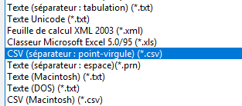
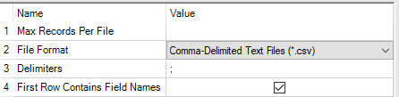
Input Data – file format
Intro | Study Management | Data Input | Data controls | Run Management | Study validation | Table Library
To reduce data volumes, the variables have been split into two files
Product file: containing all information relating to the client, treaty or product
Policy file: containing all information on granular level, relating to the insured, policy or benefit
The two files are linked via the variable Product_ID, which has to be unique and consistent between both files
The file formats have to be in .csv with “;” delimiter
Excel:
Alteryx:
SAS: PROC EXPORT DATA=SAS_TABLE_NAME
OUTFILE="\\Location\File_name.csv"
DBMS=DLM REPLACE;
DELIMITER=';’;
RUN;
In case “;” is not a provided as option, you can use the following trick: Under Options / Advanced Options / Editing section, uncheck “Use system separators” and enter “,” in decimal delimiters

Slide 21

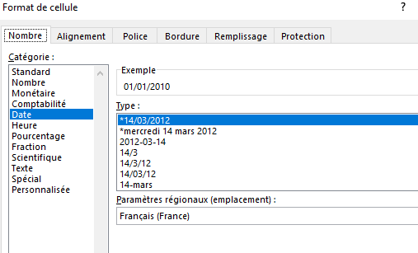
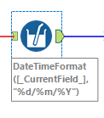
Input Data – file format
Intro | Study Management | Data Input | Data controls | Run Management | Study validation | Table Library
Numbers
No thousands delimiter
Decimal delimiter as “.” or “,” but no mixing within same variable
Attention to spaces
Date formats
Standard format of DD/MM/YYYY
Excel: In case your local default date format is different, you can change the language setting within the formatting option
Alteryx: At the end of your process use the Multi-Field formula to change all date variables to string: DateTimeFormat([_CurrentField_],"%d/%m/%Y")
SAS: format DATE1 ddmmyy10.;

Slide 22
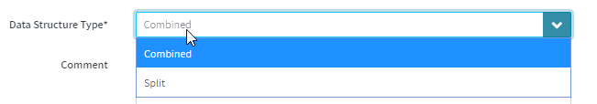
Input Data – data structure type
Intro | Study Management | Data Input | Data controls | Run Management | Study validation | Table Library
Combined
Events are linked to their corresponding exposure
In typical example one data line contains all information on the policy, its exposure and any event
Split
Events are provided separately and for some (or all) of them no link to policy info is possible
Additional variable Exposure_or_Event required in policy file to allow distinction
“Exposure”: Data line only contains exposure information
“Exposure + Event”: Same logic as Combined file. If exposure has event then it is provided on same line
“Event”: Data line only contains event information

Slide 23
Split file
Intro | Study Management | Data Input | Data controls | Run Management | Study validation | Table Library
Split file example

Slide 24
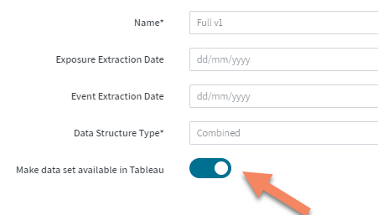
Input Data - Tableau
Intro | Study Management | Data Input | Data controls | Run Management | Study validation | Table Library
The main source of analysis and reporting is the Result Data from the calculation engine, which is automatically provided within Tableau, including all time dimensions and available input dimensions
In certain situations however information may only be available in the Input Data and it can be of interest to perform distribution analysis of the Input Data, e.g. for a more detailed Face Amount distribution or for a detailed input dimension which has been excluded from the calculation run.
In such a situation it is possible to select the below option and the data set will be automatically made available in Tableau once it has passed the data controls and has been saved.

Slide 25
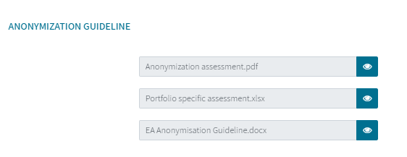
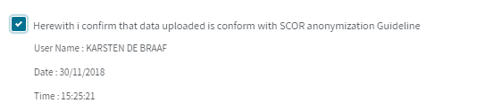
Input Data – data protection
Intro | Study Management | Data Input | Data controls | Run Management | Study validation | Table Library
Anonymization guideline has been prepared with legal to assure compliance with data protection regulations, in particular GDPR
It is critical that all data uploaded is anonymized –
the upload of personal data could lead to a breach of GDPR and potentially significant fines!
Documentation is provided on APEX
Use “Anonymization assessment” for quick assessment of your portfolio data
Familiarize yourself with the “EA Anonymization Guideline”
In case of any doubt please contact APEX support team
The compliance with anonymization guideline must be confirmed at the upload of each policy file

Slide 26
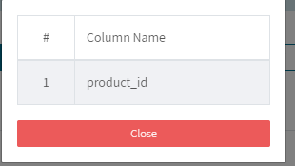
Data controls (1/3)
Intro | Study Management | Data Input | Data controls | Run Management | Study validation | Table Library
First control on any missing compulsory variables after upload of files:
Click on variable number to obtain details
Unknown columns:
Variables in data file which are not recognized, not being in data dictionary
Due to data protection regulation unknown variables have to be excluded

Slide 27
Data controls (2/3)
Intro | Study Management | Data Input | Data controls | Run Management | Study validation | Table Library
To allow easier identification of your data errors, it is recommended to upload the variable data_line, which will be included in the control report
Certain controls require the definition of a unique exposure ID, with existence of at minimum Life_ID and Policy_ID (e.g. control 3 “status consistency” or control 12 “status date overlap”)
Controls can be blocking or warning
Blocking: File is not accepted and error has to be corrected. So far mostly relating to cases where data would case error in calculation engine
Warning: A data inconsistency has been detected but user can decide to proceed with the file

Slide 28
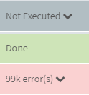
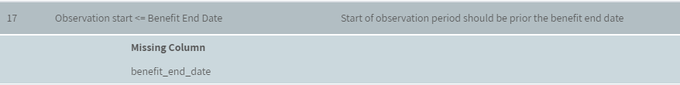
Data controls
Intro | Study Management | Data Input | Data controls | Run Management | Study validation | Table Library
Three types of control message
At least one variable required for the control is not contained in the input file
Control has been applied and no error has been detected
At least one error has been detected
Clicking on the arrow will provide more details
Missing data variables
Up to 5 samples with respective data causing error

Slide 29
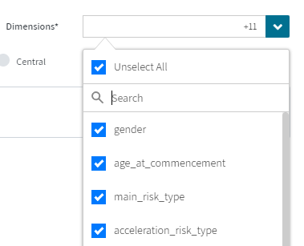
Run Management
Intro | Study Management | Data Input | Data controls | Run Management | Study validation | Table Library
Up to five runs can be created
Dataset
First step is selection of Dataset. Several parameters depend on the dataset chosen, therefore any change in dataset will reset all run parameters
Dimensions
Possibility to remove certain dimensions from results
By default not required.
Recommended if quality of dimension is not reliable or if dimension is very granular, leading to very large result file
Exposure metric
“Initial”: Standard option for calculating annual decrement probabilities, based on “Balducci” assumption
“Central”: Option for calculating instantaneous decrement rates (e.g. force of mortality)
APEX field
Data variable

Slide 30
Run Management
Intro | Study Management | Data Input | Data controls | Run Management | Study validation | Table Library
Result metrics
In case required variables are missing or incomplete, then the options are greyed-out
For example, By Amount Analysis requires
Risk_Amount_Insurer and Event_Amount_Insurer, or
Risk_Amount_Reinsurer and Event_Amount_Reinsurer
By Amount Capped produces separate results with risk amounts and event amounts capped at limit
Loss Ratio Analysis based on Annual_Premium_Insurer / Annual_Premium_Reinsurer
Automatic Risk Amount Change
will automatic adjust exposure amount for decreasing/increasing products based on constant rate and its frequency
controlled by Benefit_Change_Rate_Type variable
Simple/ Compound: Change Risk Amount based on Benefit_change_rate_annual and Benefit_change_frequency
Loan Interest: Reduce Risk Amount to 0 over duration (Benefit_term_years) in addition to interest rate

Slide 31
Run Management
Intro | Study Management | Data Input | Data controls | Run Management | Study validation | Table Library
Rating Adjustment Method
“Adjust expected”: Adjust expected events based on ratings provided in policy file (details in Annex A)
Only applied to ix and qx
Only applied to “by count” and “by amount”
Policy adjustment Joint Life lapses
“0.5”: For lapses, exposure and events are adjusted in case of Joint Life (Joint_Life_Type)

Slide 32
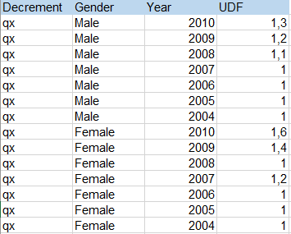
Run Management - IBNR
Intro | Study Management | Data Input | Data controls | Run Management | Study validation | Table Library
Adjustment for IBNR
Separate result variables are provided with & with-out IBNR
“Amount allocation”: Allocation method currently specific to US process
“Manual UDF”: Upload of table with ultimate development factors
Decrement (compulsory)
Time-dimension (compulsory): Either Year / Half-Year / Quarter / Month
UDF (compulsory): development factor
Any dimension variable of input file can be added
Factors can be differentiated by Result_metric (by count / by amount)
Controls executed:
UDF > 0
All dimensions in IBNR table are included in Dataset
Time-dimension covers entire Study observation period, as provided in Study definition

Slide 33
Run Management – decrement options
Intro | Study Management | Data Input | Data controls | Run Management | Study validation | Table Library
It is recommended to include any decrement in your study for which data is reliable
Extract maximum insights for all internal users and all future uses
Avoid the need for later “re-runs” or duplication of studies
Whenever possible all decrements should be calculated within the same Run, later defined as “Master Run”
Slicing Dimensions
Wherever possible include all dimensions
Attained Age not available if Date of Birth missing
Policy Duration, not available if Date of Commencement missing

Slide 34
Run Management – decrement options
Intro | Study Management | Data Input | Data controls | Run Management | Study validation | Table Library
Leading Slicing Dimension
Relevant only for Initial Exposure Metric
Defines the type of anniversary date the exposure is extended to in case of an event
Represents the main axis of analysis for your study
For biometric risks typically Age Attained, or Policy Duration in case of select/ultimate table
For withdrawals typically Policy Duration
Calendar Year for trend analysis
Study Period
Defaulted with the Observation Period from the Study Definition
Possibility to restrict for run

Slide 35
Run Management – Expected Basis
Intro | Study Management | Data Input | Data controls | Run Management | Study validation | Table Library
“US method”: Only used for US inforce study process
“Default method”: Option for everybody else
Expected Basis Selection
Up to 10 Basis can be defined, which will all be provided as separate result variables
Each Basis is comprised of up to three tables
Base Table (compulsory): Base reference table, for example industry table or internal pricing basis
Adjustment Table (optional): Adjustment factors from base table to specific study scope, for example client specific adjustment
Trend Table (optional): Adjustments by Calendar Year to normalize trends to a fixed reference year. Recommended to calibrate trend factors to reference year of Base Table
Tables are selected from the table library; pre-filtered to given decrement type
If table selected belongs to a different country than the study country, a warning is displayed
Similarly if exposure metric (initial / central) of the table is different from the Run parameters, a warning is displayed
All dimensions of the expected tables need to be present in the input dataset (blocking control)

Slide 36





Run Management – Run status
Intro | Study Management | Data Input | Data controls | Run Management | Study validation | Table Library
Run is set-up and files are transferred to SAS server. If this process takes longer than 5min (for a file < 500MB) then you might have detected a platform bug. Please let us know ☺
Calculation run has started. Additional details are provided in section “Description”
Run is finished and results are being integrated into reporting DB. Results can already be downloaded as Excel-file from the platform
Results are ready to be consumed in Tableau
Run has been aborted by SAS engine due to a data error. Details are provided in section “Description”. For example:
EA OUTPUT AFTER SLICING IS EMPTY FOR RUN_ID NUMBER xxx Chosen observation period leads to empty result file
ERROR: Duration slicing is missing whereas at least one of Temporary Multiplicative or Additive Extra Rating is provided
General platform error outside of the SAS engine. This would likely be related to a bug, please let us know

Slide 37

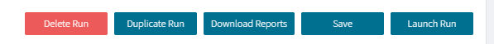
Run Management – Run results
Intro | Study Management | Data Input | Data controls | Run Management | Study validation | Table Library
Once the run is finished, all study results are automatically integrated into the global reporting DB and available in Tableau http://dcvprdtableau.eu.scor.local
Additional option to download results as csv file directly from platform:
For Result files <1m lines, SAS will produce a “.xls” file instead of “.csv” to facilitate download
Result from all decrements are combined in one file

Slide 38
Access rights
Intro | Study Management | Data Input | Data controls | Run Management | Study validation | Table Library
Two dimensions of user rights and access rights have been defined, one related to the general platform and one specific to the given study
User role
Creator: Ability to create and modify studies and tables
Default: Read-only access
Study role
Groups have been defined in line with the different stages of a study
In Progress: Access limited to producer and his team
Validate: Access provided to the requester of the study and users with justified interest (“private clients”)
Publication: Global access
Study status | Default access right
In progress | Producers
Validated | Producers + private Clients
Published | Producers + all Clients
Cancelled | Producers
Phase 2

Slide 39
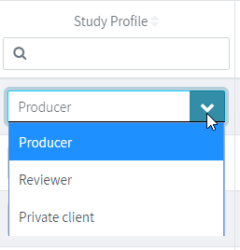
Study roles
Intro | Study Management | Data Input | Data controls | Run Management | Study validation | Table Library
Simplified, the study access rules are as follows:
*A Producer who is not Creator is called Reviewer
For each study an allocation of all EA users to the different study roles is performed, based on the profile of the creator of the study.
Private Clients are defined based on the purpose (pricing/ reserving / …) and market of the study. Detailed rules in Annex B
This allocation is only a default allocation and can be modified by the producer manually at any time
Study role | Study in progress | Study validated
Producer | Read + Write | Read + Write
Reviewer * | Read | Read
Private Client | None | Read
Other | None | None

Slide 40
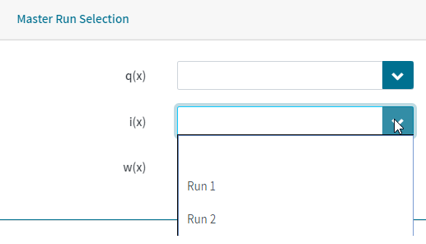
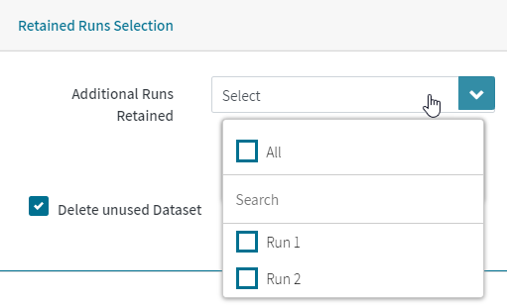
Study Validation
Intro | Study Management | Data Input | Data controls | Run Management | Study validation | Table Library
Once a study is finalized, it is set to Validated and the Master Run for each decrement is chosen (in most cases the same)
Once a study is validated, access to the study and its results is provided to all Private Clients and the Study Runs can no longer be modified
By default all other runs are deleted.
Additional runs can be retained for documentation purpose
By default all unused datasets are deleted

Slide 41
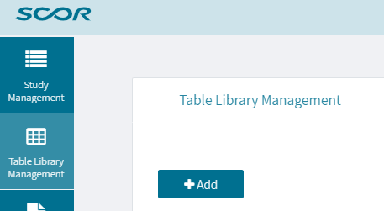
Table Library
Intro | Study Management | Data Input | Data controls | Run Management | Study validation | Table Library
Similar principles to Study Management
Table Name
Official name of external or internal table
For adjustment tables, define your local standard for a meaningful description of the scope of the table (e.g. Client & product name)
Table Type
Policy table specific to US inforce studies
Exposure metric
Only compulsory for Base table
Application year
Reference year of the table. For example mid-point of underlying observation period or base year of a trend table
Used to control that selected trend table and base table are consistent
Compulsory for base and trend table
Publication year
Creation resp. publication year. Used in table year to allow distinction of table updates
Table ID
Defined as combination of key metadata: CountryCode_Decrement_TableType_TableName_PublicationYear_VersionID
In case table ID combination already exists then the creation of a new version will be confirmed via pop-up

Slide 42
Table Library
Intro | Study Management | Data Input | Data controls | Run Management | Study validation | Table Library
Table data formats similar for all three table types:
Age_Attained
Attained_Age_definition
Insurance_Age_Attained
Insurance_Age_Attained_def
Duration_Year
Any dimension variable of input file can be added
Factors can be differentiated by Result_metric (by count / by amount)
Data_Line to allow identification of data errors
Additional variable Calendar_Year for trend table

Slide 43
Table Library
Intro | Study Management | Data Input | Data controls | Run Management | Study validation | Table Library
Rate (compulsory)
Base Table: Rate
Adjustment table: Adjustment
Trend table: Trend_adjustment
Example:
data_line | Attained_Age_definition | Result_Metric | Gender | Smoker_status | Age_attained | Rate
1 | Age Last Birthday | By Count | Male | Non Smoker | 1 | 0,00032828
2 | Age Last Birthday | By Count | Male | Non Smoker | 2 | 0,00032828
3 | Age Last Birthday | By Count | Male | Non Smoker | 3 | 0,00032828
4 | Age Last Birthday | By Count | Male | Non Smoker | 4 | 0,00032828
5 | Age Last Birthday | By Count | Male | Non Smoker | 5 | 0,00032828
6 | Age Last Birthday | By Count | Male | Non Smoker | 6 | 0,00032828

Slide 44
Expected table – age variables
Intro | Study Management | Data Input | Data controls | Run Management | Study validation | Table Library
Only one type of age variable is accepted (Age_attained / insurance_age_attained /age_at_commencement)
The corresponding age definition variable needs to be provided in the table
The matching of exposure data with expected table and IBNR table is performed as follows:
Age variable | Age definition variable | Exposure | Expected/ IBNR
Age attained | Attained_age_definition | Definition provided in Run parametrization | Definition provided in table
Age at Commencement | Age_at_commencement_definition | Definition provided in Product Input File | Definition provided in table
Insurance age attained | Insurance_age_attained_def | Set equal to age_at_commencement_definition | Definition provided in table

Slide 45
Table Library – access rights
Intro | Study Management | Data Input | Data controls | Run Management | Study validation | Table Library
Modification
Once a table has been used in a run, it can no longer be modified
Confidential
Non-confidential tables can be seen and used by any users
By default certain tables are set to confidential
Confidential status can be set and changed manually by table producer
Confidential tables are limited to users from same market (similar principles as applied by Pricing guidelines)
All tables where user has not access rights are removed from selection list in Run parametrization
Inactive
A table can be set to inactive
If such table is selected in the Run parametrization then a warning will be displayed

Slide 46
Experience Analysis Project
ANNEX
A
Rating Adjustment Method
B
Private client definition

Slide 47
Annex A - Rating adjustment method
Expected_rate_adjusted = Expected_rate * ( 1 + Perm_Mult_Extra_Rating_1 + Perm_Mult_Extra_Rating_2 + if(duration_year <= Temp_Mult_Extra_Rating_Term_1; Temp_Mult_Extra_Rating_1; 0) + if(duration_year <= Temp_Mult_Extra_Rating_Term_2; Temp_Mult_Extra_Rating_2; 0) ) + Perm_Add_Extra_Rating_1 + Perm_Add_Extra_Rating_2 + if(duration_year <= Temp_Add_Extra_Rating_Term_1; Temp_Add_Extra_Rating_1; 0)) + if(duration_year <= Temp_Add_Extra_Rating_Term_2; Temp_Add_Extra_Rating_2; 0))

Slide 48
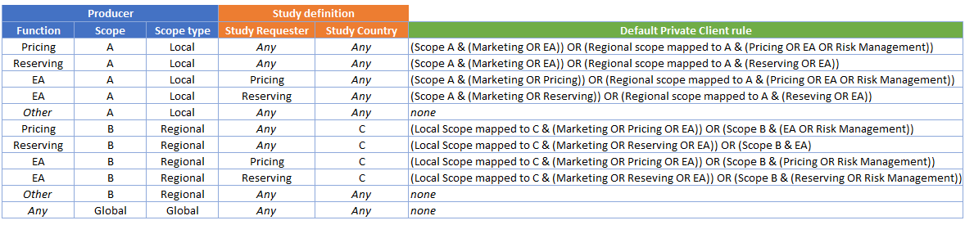
Annex B – Private client definition
The default « Private Clients » for a given study are defined as follows, taking into account the characteristics of the producer and of the study:

